Slide 1

[Table Tablet Menu System]

Slide 2
Summary
Conducted survey for the 50 customers that participated test launch.
Overall experience of tablet menu system= 72% participant give positive rating
Waiter instruction about the working of the table= 76% positive with the instruction.
Usability of tablet= 30% were neutral and 48% feel it is easy to use.
Table wait time= 54% had to wait for 15+ minutes.
Time to receive food order= 56% got their order in 20 minute or less.
Accuracy of order with new system= 72% were satisfied.
Checkout process= 82% were satisfied.
New system experience vs traditional experience= 40% were satisfied with new system, 30% like mix of tablet ordering and waiter interaction.
Technical issue= 88% find no technical issue with the tablet.

Slide 3
The data from the survey give key detail about the project and some of the key finding are-
Experience of the tablet is mostly positive.
Tablet is easy to use by majority of participant.
Wait time is higher 54% of participant had to wait for 15+ minute which is a problem.
Time to receive order in 20 min or less which less than expected time of 30 minutes.
Order accuracy is 72% which is far less than expected 98%.
Technical issue in tablet is 88% is less than expected 95%.
Response on Check out time is positive.
Overview

Slide 4
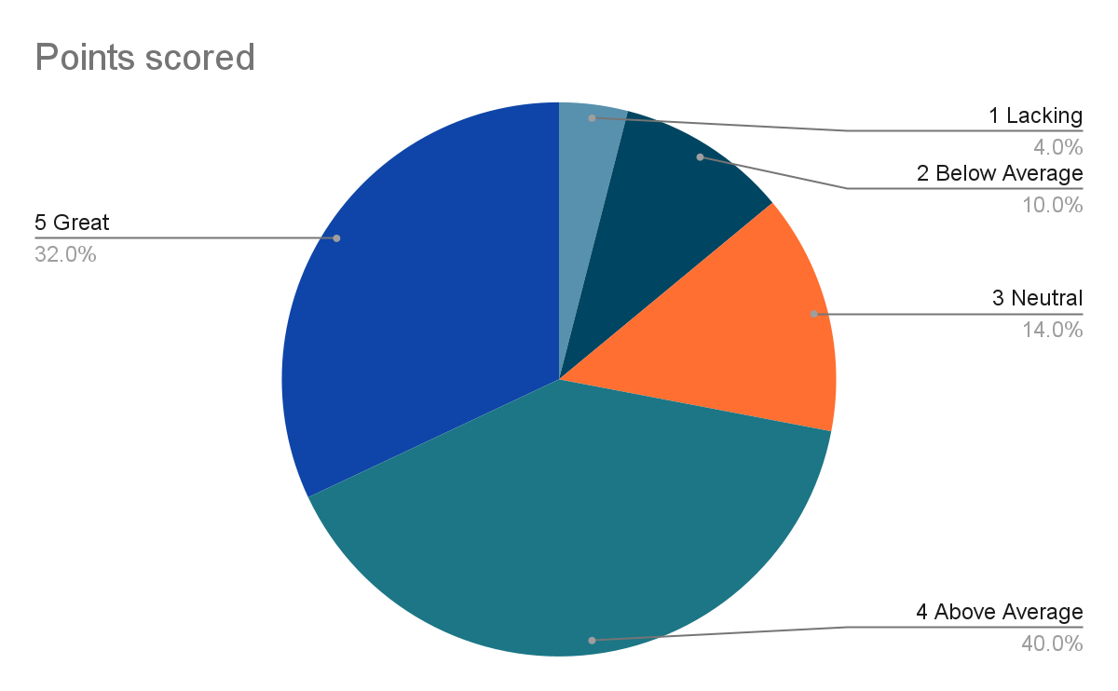
Rate experience with the tablet overall.
1 Lacking
4
2 Below Average
10
3 Neutral
14
4 Above Average
40
5 Great
32
Findings

Slide 5
Survey does not present time taken by each order. This was one of the milestone to improve the order time for appetizer by 8 minute and entree by 12-15 minutes.
Survey does not evaluate the design of the of new menu system.
Try to encourage the use of tablet for other order and evaluate its impact on those order.
Next Steps

Slide 6
Survey must include separate evaluation from each restaurant for more diverse result.
Next Steps

